Slide 1
PX5510/PX5518
Statistics and Time Series Analysis
Time Series Analysis
2024-25 Term 2
Department of Physics
Prof. M. Carmen Romano m.romano@abdn.ac.uk Meston 337
Dr Roland Young roland.young@abdn.ac.uk Fraser Noble 154

Slide 2
Time Series
A time series is a sequence of data points listed in time order, usually equally-spaced in time
Time is an independent variable and provides a natural temporal ordering
Time series analysis: Used to extract meaningful statistics and other characteristics from the data
Time series forecasting:
Building a model to predict future values based on previously-observed values
Time series are typically characterised by
trends, periodicities, seasonality, variability, noise, and chaos

Slide 3
Time Series
Time series are typically characterised by
Trends: Long-term persistent increases or decreases in the data (e.g. “global warming”)
Cycles: Rises and falls over long time scales (e.g. the “business cycle”)
Seasonality: Regular changes over a known time period usually less than a year (e.g. depending on time of year, day of the week, day of the month)
Variability: Short-term fluctuations which aren’t due to random noise (e.g. “weather”)
Noise: Random or irregular influences that manifest over all time scales
Chaos: Behaviour that appears random but is actually deterministic Only occurs in nonlinear systems

Slide 4
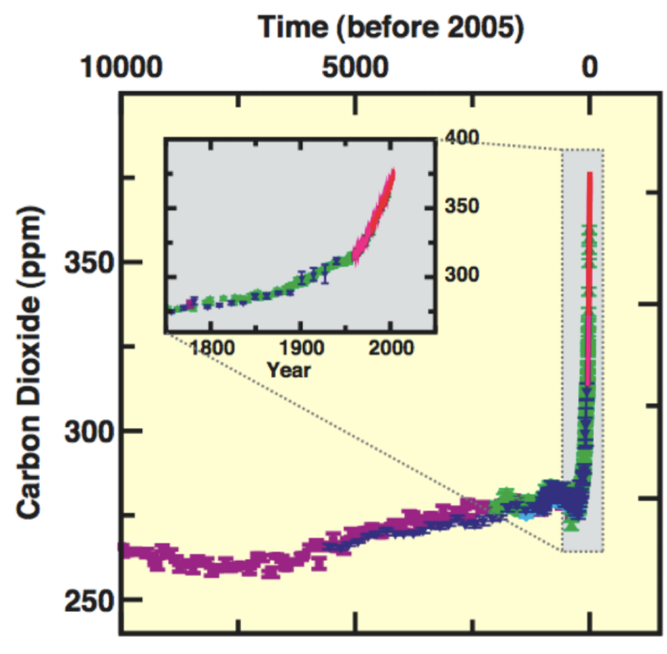
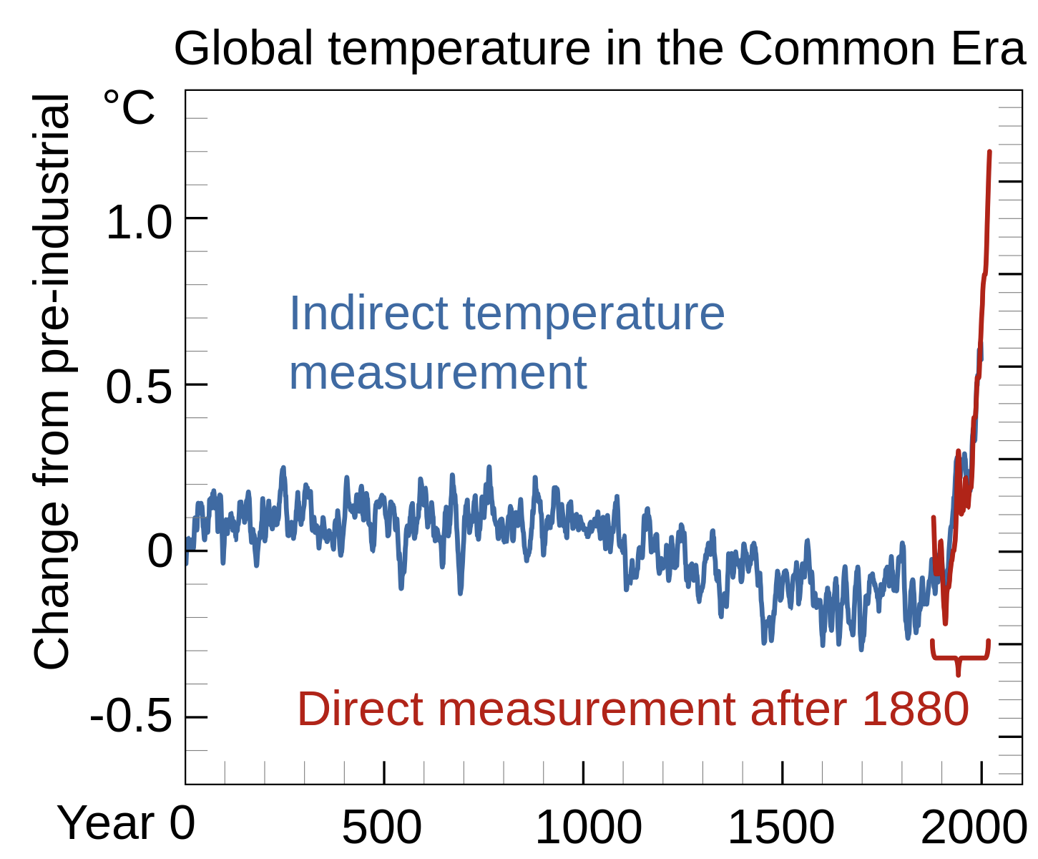
Time Series
Example: Historical trends in CO₂ and temperature
[IPCC 2007, Efbrazil CC BY-SA 4.0]

Slide 5
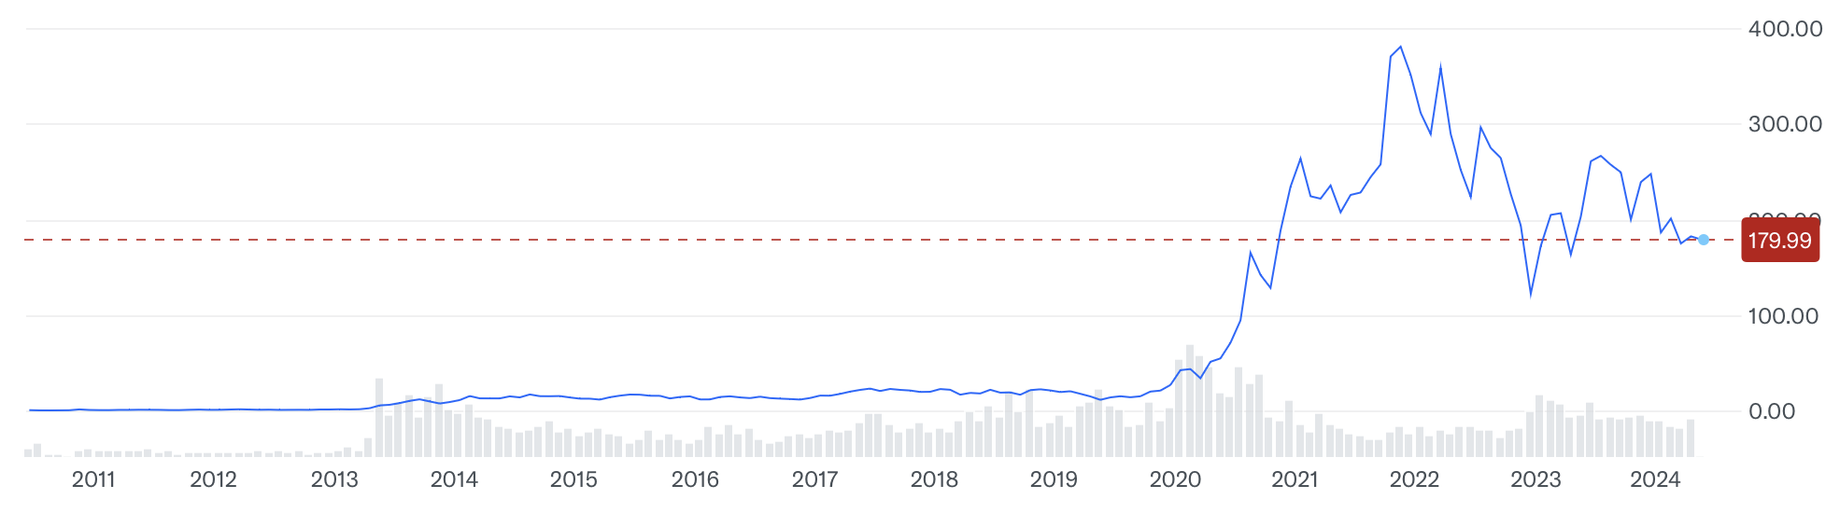
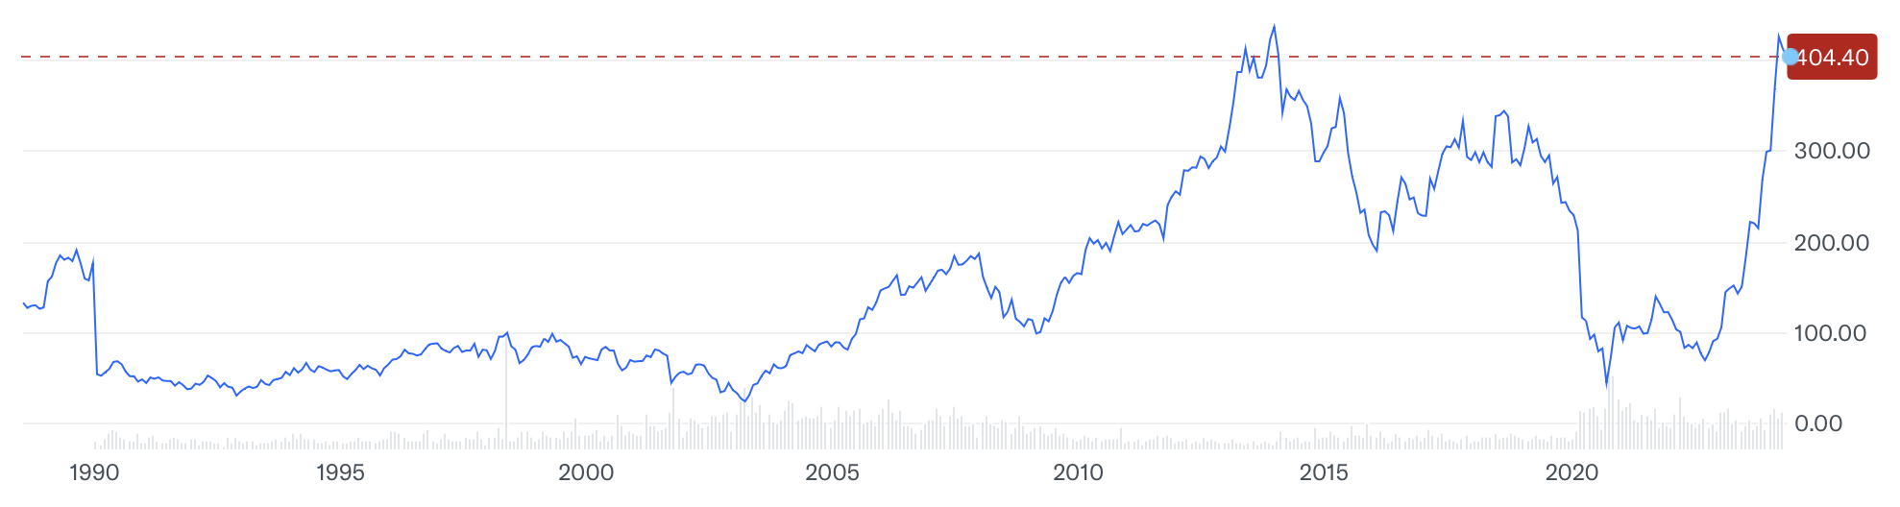
Time Series
Example: Stock market prices
Tesla, Inc. (TSLA)
Rolls-Royce Holdings PLC (RR.L)
[https://finance.yahoo.com/]

Slide 6
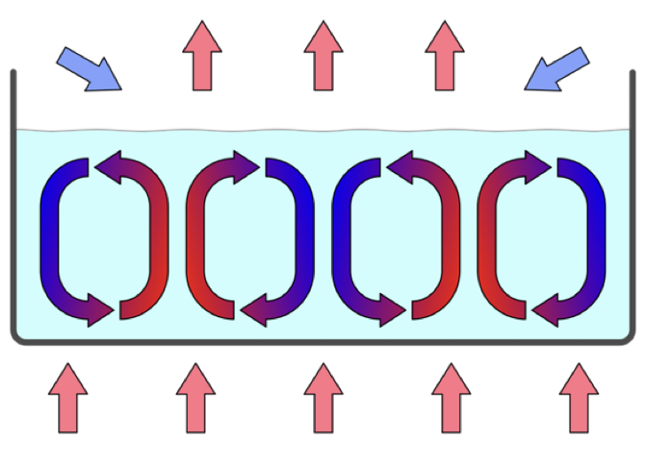
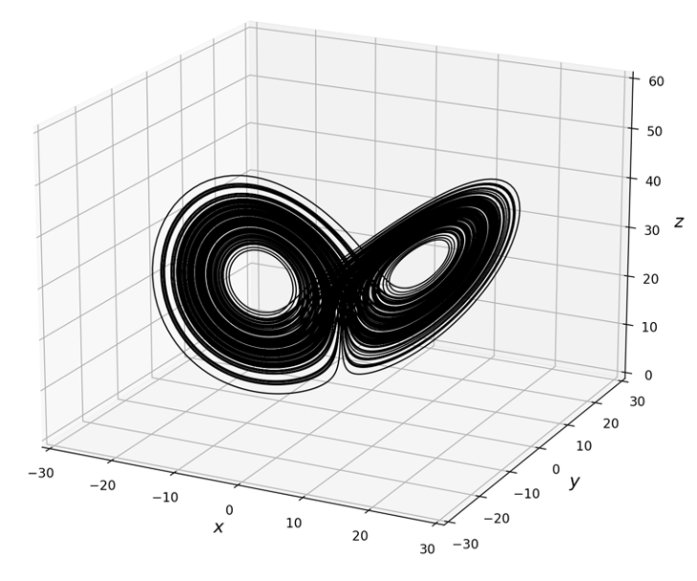
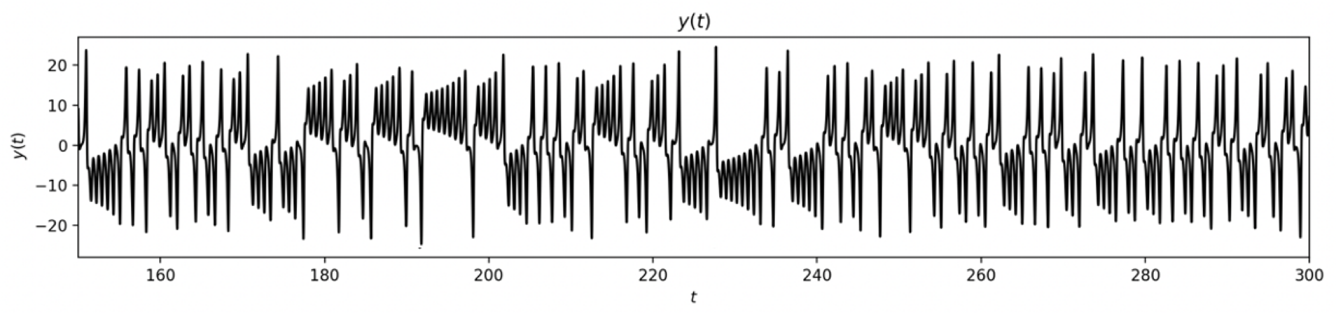
Time Series
Example: Lorenz attractor (chaos)
[Eyrian, CC-BY-SA 3.0]

Slide 7
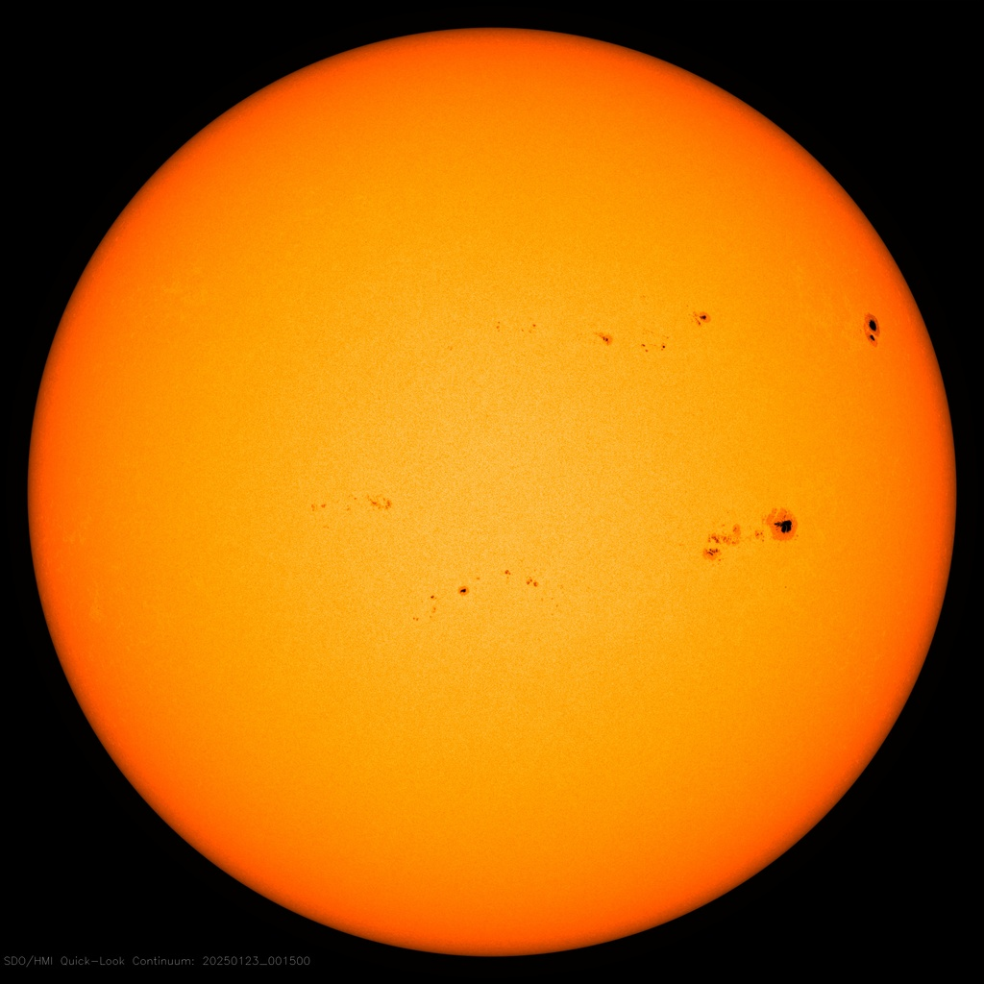
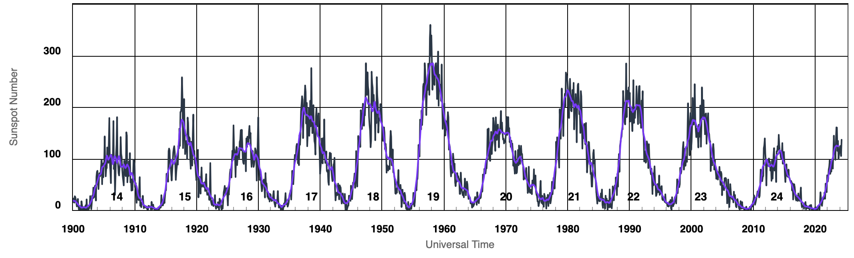
The Sun on 29 January 2025
Time Series
Example: The Solar cycle
Number of sunspots since 1900
[NASA SDO, swpc.noaa.gov]

Slide 8
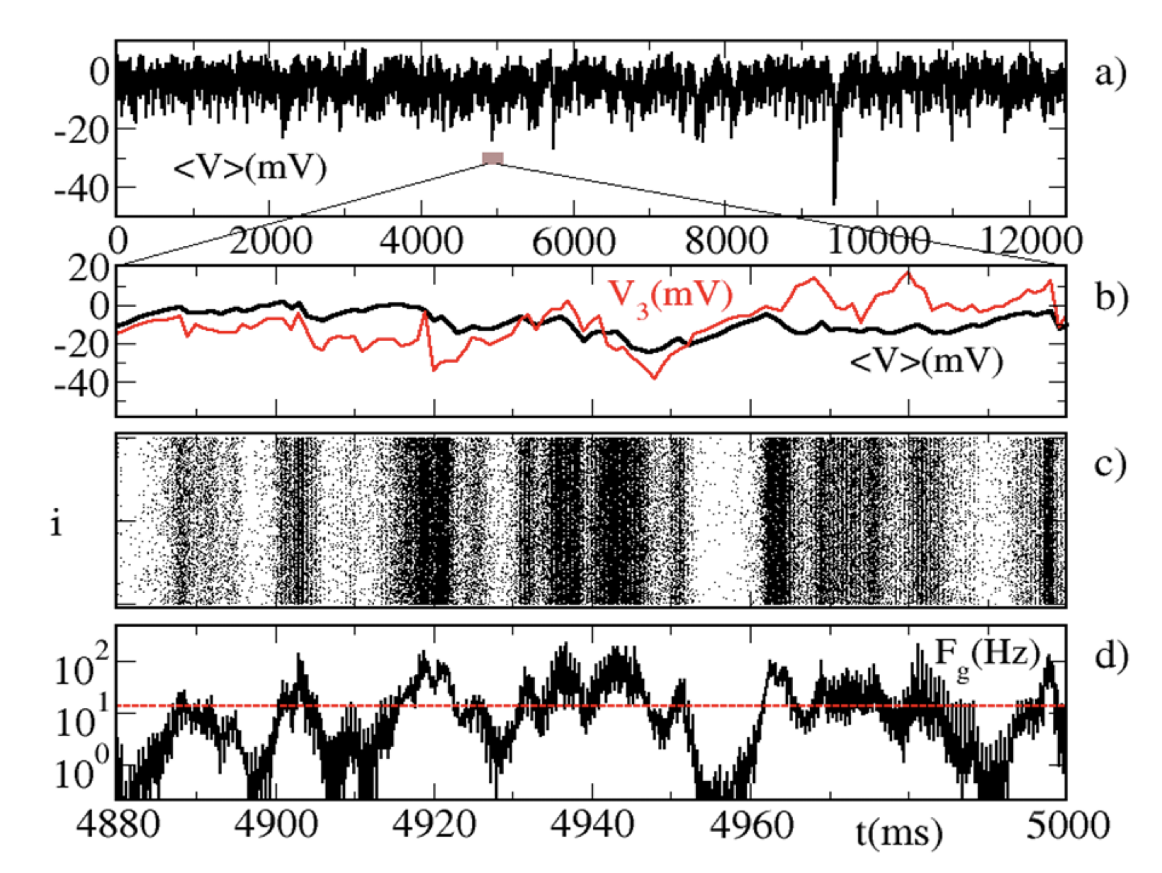
Time Series
Example: Multivariate neuronal data
Continuous data, equally-spaced sampling in time
Membrane potential of a single neuron
Mean field – ensemble average
Discrete data spike event of oscillator i at discrete time points
Instantaneous frequency, from binning panel (c)
[Ekke Ullner]

Slide 9
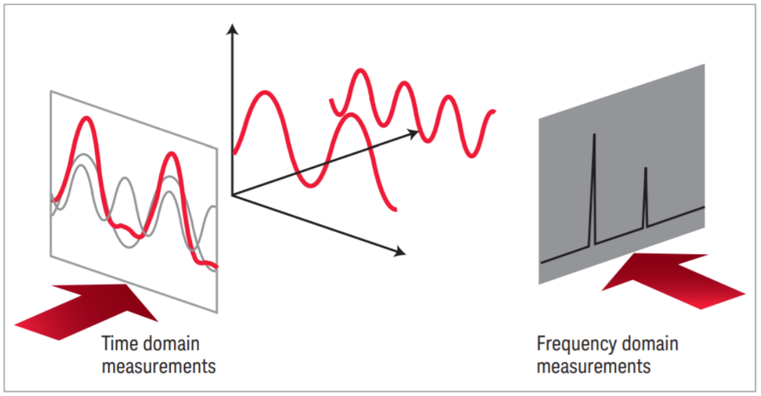
Time-domain and frequency-domain
Time domain: Analyse data as a function of time
A time-domain graph shows how a signal changes over time
Frequency domain: Analyse data as a function of frequency
A frequency-domain graph shows how much of the signal lies within each frequency band over a range of frequencies
[Keysight]

Slide 10
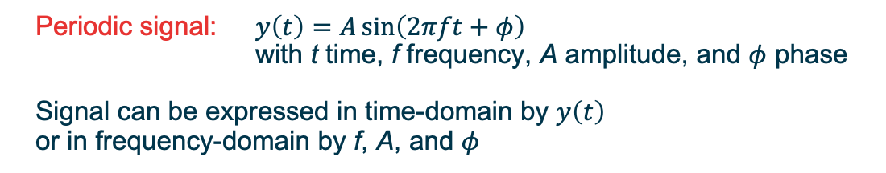
Time-domain and frequency-domain
Time series composed of one periodic signal
Time series
Frequency spectrum
Periodic signal: $y\left(t\right)=A\sin\left(2πft+φ\right)$ with t time, f frequency, A amplitude, and $φ$ phase
Signal can be expressed in time-domain by $y\left(t\right)$
or in frequency-domain by f, A, and $φ$

Slide 11
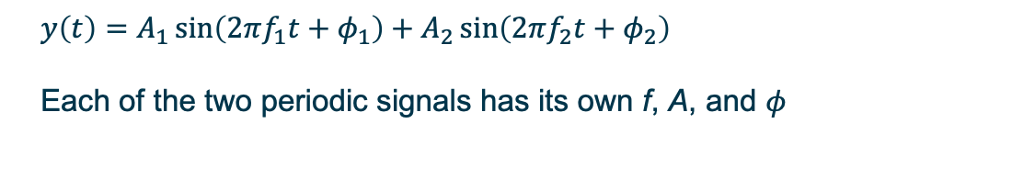
Time-domain and frequency-domain
Time series composed of two periodic signals
Time series
Frequency spectrum
$$y\left(t\right)=A_{1}\sin\left(2πf_{1}t+φ_{1}\right)+A_{2}\sin\left(2πf_{2}t+φ_{2}\right)$$
Each of the two periodic signals has its own f, A, and $φ$

Slide 12
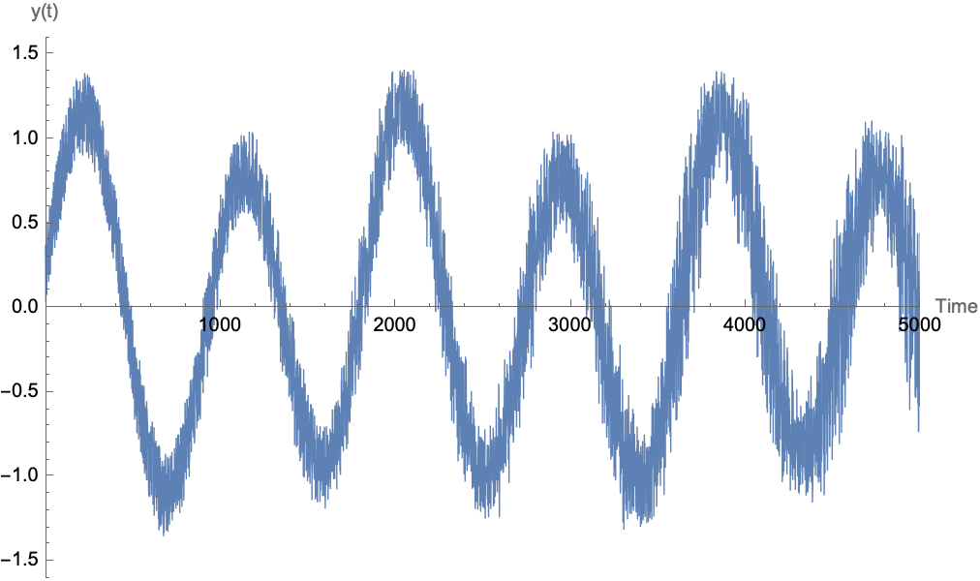
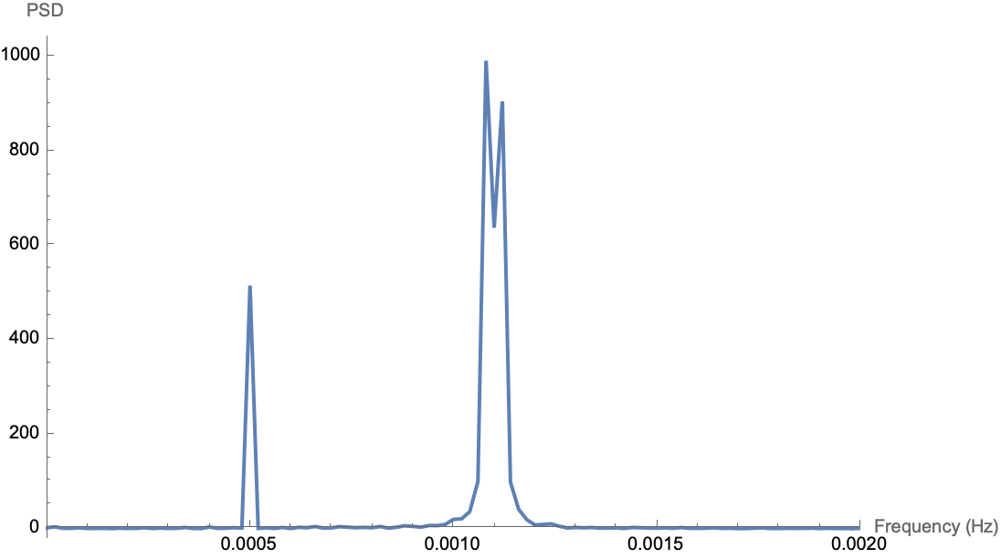
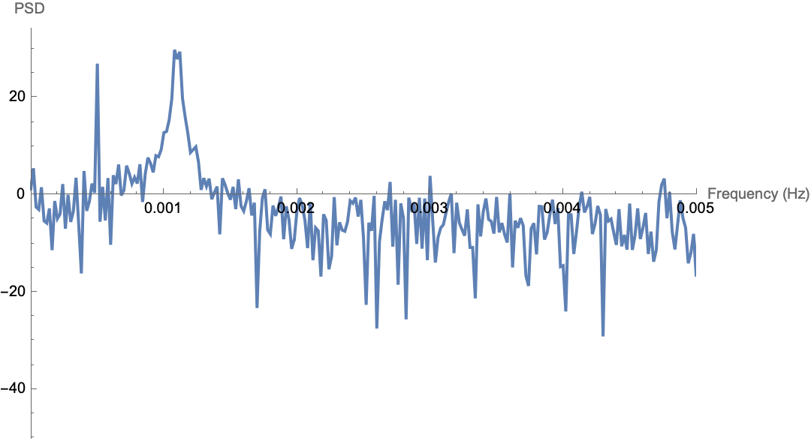
Time-domain and frequency-domain
Multiple periodic signals plus noise
Frequency spectrum
– Linear y-axis
Time series
Frequency spectrum
– Logarithmic y-axis
Noise manifests in the frequency domain at all frequencies
This is white noise: Same amplitude at all frequencies
Note x-axis ranges are different

Slide 13
Time-domain analysis
Visualisation and processing in Mathematica
Plotting using line charts: ListLinePlot
Binning the data: BinCounts
(grouping data by some property)
Smoothing the data: MovingAverage MovingMedian MeanFilter
(producing a visually smoother time MedianFilter MinFilter MaxFilter
series to identify underlying trends) GaussianFilter
Filtering the data: GradientFilter LaplacianFilter
(modifying certain frequencies) LowpassFilter HighpassFilter BandpassFilter
Interpolating or fitting the data: Interpolation Fit FindFit
(predicting values at arbitrary times) LinearModelFit NonlinearModelFit
Examples: 01_spiketimes.nb (Binning)
02_interpolation_fit.nb (Interpolation and fitting)

Slide 14
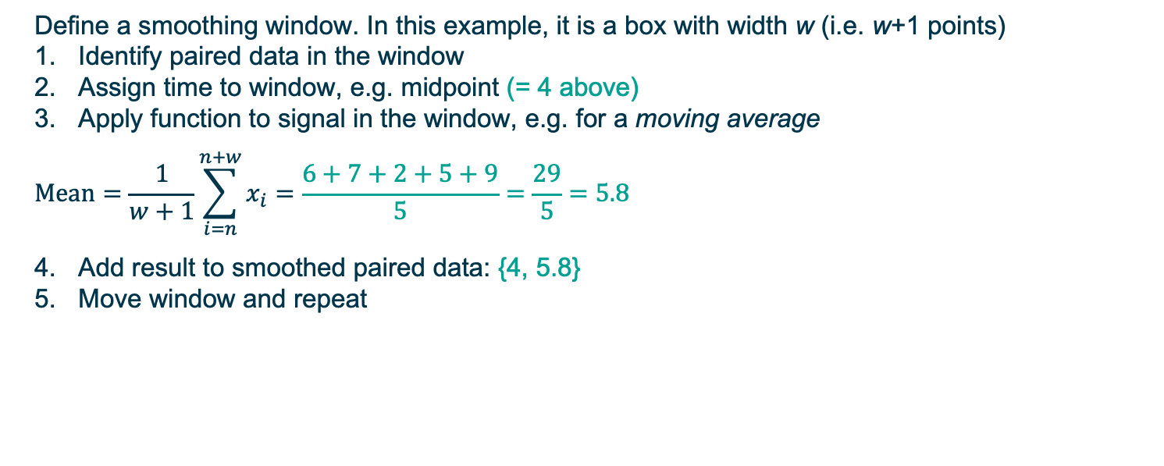
Smoothing data
Window with width w = 4 at n = 3
Index n: 1, 2, 3, 4, 5, 6, 7, 8, 9, 10, 11, 12, 13, 14, 15, …
Time t: 0, 1, 2, 3, 4, 5, 6, 7, 8, 9, 10, 11, 12, 13, 14, …
Signal x: 3, 5, 6, 7, 2, 5, 9, 32, 42, 12, 24, 33, 46, 86, 11, …
Define a smoothing window. In this example, it is a box with width w (i.e. w+1 points)
Identify paired data in the window
Assign time to window, e.g. midpoint (= 4 above)
Apply function to signal in the window, e.g. for a moving average
$$Mean=\frac{1}{w+1}\sum_{i=n}^{n+w}{x_{i}}=\frac{6+7+2+5+9}{5}=\frac{29}{5}=5.8$$
Add result to smoothed paired data: {4, 5.8}
Move window and repeat
Mathematica: MovingAverage
MeanFilter

Slide 15
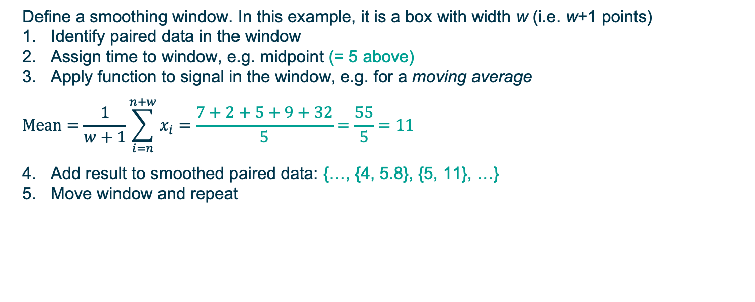
Smoothing data
Window with width w = 4 at n = 4
Index n: 1, 2, 3, 4, 5, 6, 7, 8, 9, 10, 11, 12, 13, 14, 15, …
Time t: 0, 1, 2, 3, 4, 5, 6, 7, 8, 9, 10, 11, 12, 13, 14, …
Signal x: 3, 5, 6, 7, 2, 5, 9, 32, 42, 12, 24, 33, 46, 86, 11, …
Define a smoothing window. In this example, it is a box with width w (i.e. w+1 points)
Identify paired data in the window
Assign time to window, e.g. midpoint (= 5 above)
Apply function to signal in the window, e.g. for a moving average
$$Mean=\frac{1}{w+1}\sum_{i=n}^{n+w}{x_{i}}=\frac{7+2+5+9+32}{5}=\frac{55}{5}=11$$
Add result to smoothed paired data: {…, {4, 5.8}, {5, 11}, …}
Move window and repeat
Mathematica: MovingAverage
MeanFilter

Slide 16
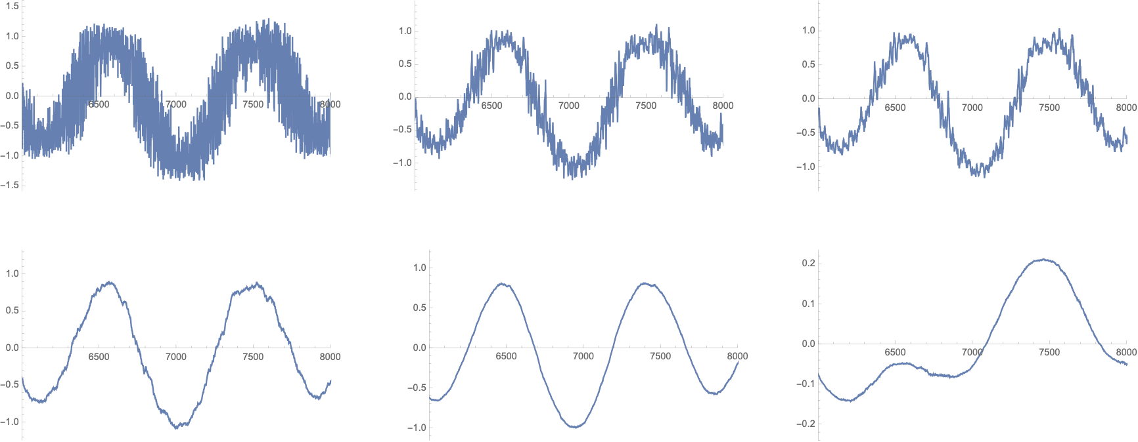
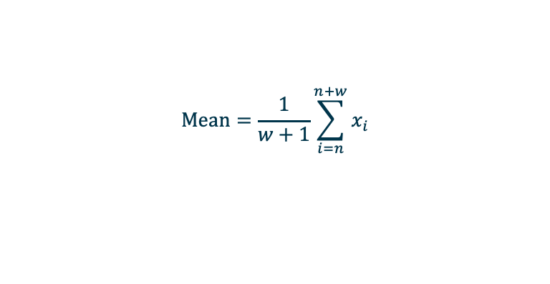
Smoothing using a moving average of different widths
$$Mean=\frac{1}{w+1}\sum_{i=n}^{n+w}{x_{i}}$$
Signal x: 3, 5, 6, 7, 2, 5, 9, 32, 42, 12, 24, 33, 46, 86, 11, …
Window
Raw data
w = 5
w = 10
w = 50
w = 200
w = 1000
Mathematica: MovingAverage, MeanFilter

Slide 17
Choice of smoothing functions
MeanFilter Replace data in window with mean value (moving average)
Choose width depending on which frequencies you want to remove
MedianFilter Replace data in window with median value
Good where there are large outliers that would skew a mean filter
MinFilter Replace data in window with minimum value
MaxFilter Replace data in window with maximum value

Slide 18
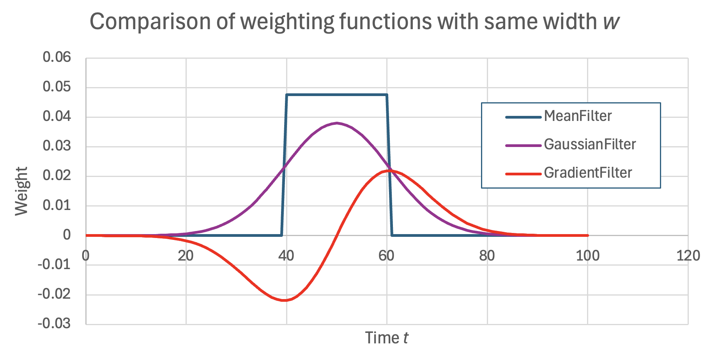
Choice of smoothing functions
GaussianFilter Replace data in window with a weighted average
Weighting function is a Gaussian centered on the middle of the window
(Compare with a step function for the mean filter)
Width is the standard deviation of the Gaussian
Compare with MeanFilter:
More weight at middle of window
Individual points do not suddenly enter and leave the window
Individual points exert an influence over a larger range of smoothed points
Smoothing is “gentler”
Preserves sharp changes better
Includes whole time series in each sum
GradientFilter Replace data with an approximation of the gradient of the time series at each point
Mathematica smoothes using the gradient of the Gaussian function as the weights
Use when you want to find where the time series changes rapidly
LaplacianFilter: Similar effect, replacing data with
its approximate second derivative
Example: 03_smoothing.nb

Slide 19
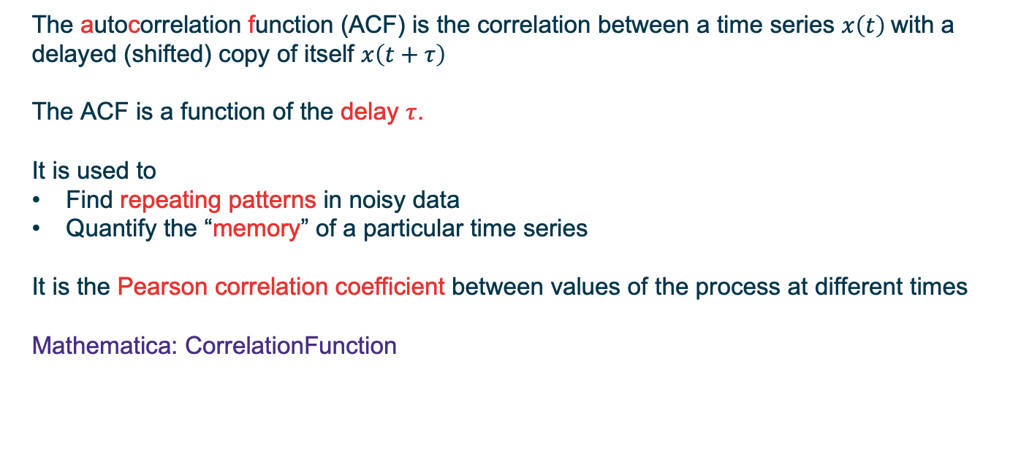
Autocorrelation
The autocorrelation function (ACF) is the correlation between a time series $x\left(t\right)$with a delayed (shifted) copy of itself $x\left(t+τ\right)$
The ACF is a function of the delay $τ$.
It is used to
Find repeating patterns in noisy data
Quantify the “memory” of a particular time series
It is the Pearson correlation coefficient between values of the process at different times
Mathematica: CorrelationFunction

Slide 20
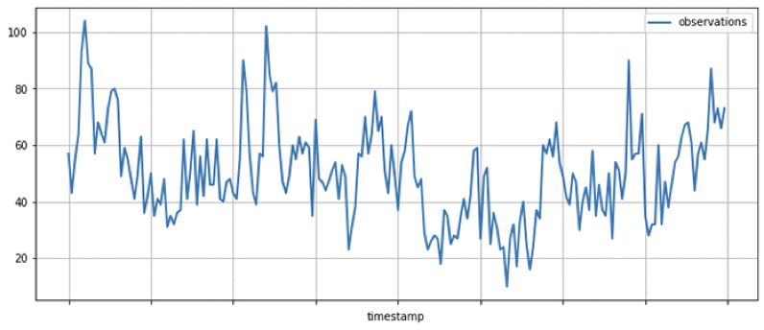
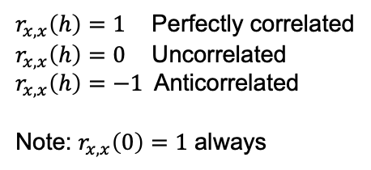

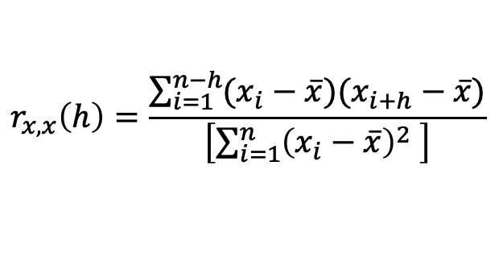

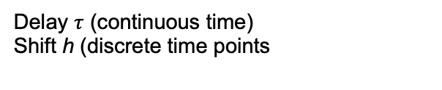
Autocorrelation
Original time series
Pearson correlation coefficient
$$r_{x,x}\left(h\right)=\frac{\sum_{i=1}^{n−h}{(x_{i}−\overline{x})(x_{i+h}−\overline{x})}}{\left[\sum_{i=1}^{n}{{\left(x_{i}−\overline{x}\right)}^{2} }\right]}$$
Delay $τ$ (continuous time)
Shift h (discrete time points
$$r_{x,x}\left(h\right)∈[−1, 1]$$
$$τ=h δt$$
$r_{x,x}\left(h\right)=1$ Perfectly correlated
$r_{x,x}\left(h\right)=0$ Uncorrelated
$r_{x,x}\left(h\right)=−1$Anticorrelated
Note: $r_{x,x}\left(0\right)=1$ always
Delayed time series

Slide 21
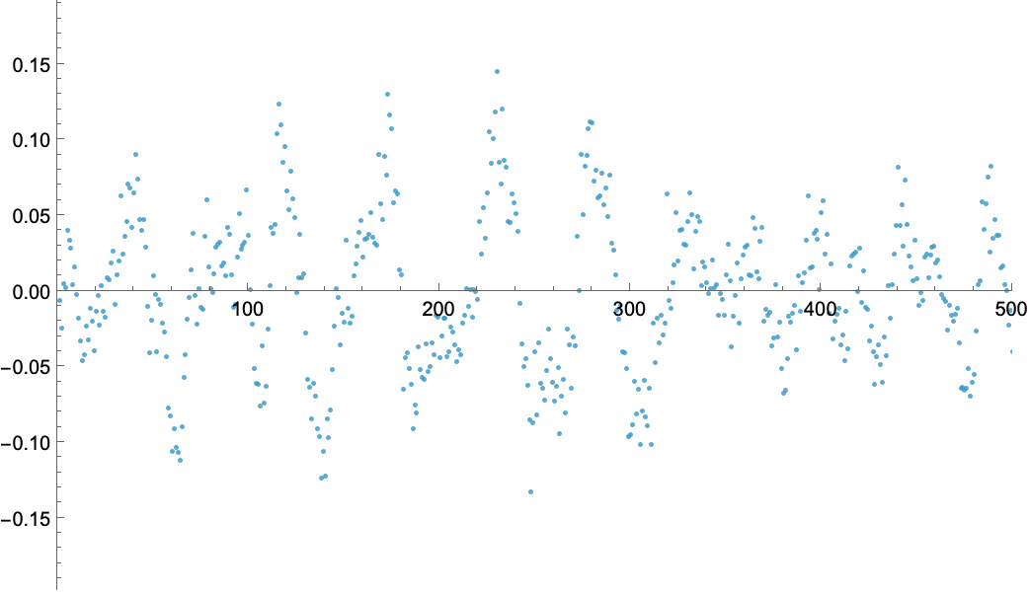
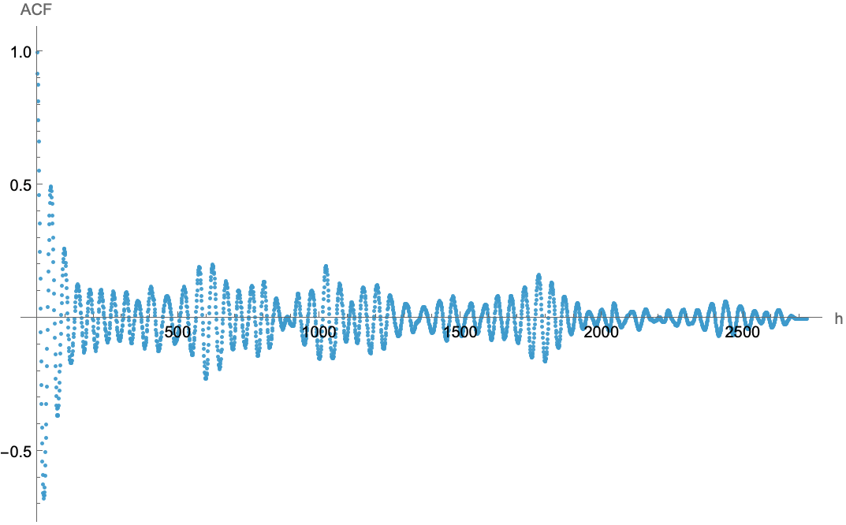

Autocorrelation
Time series
Autocorrelation function
$$τ$$
Example: 04a_autocorrelation_hands_on.nb

Slide 22
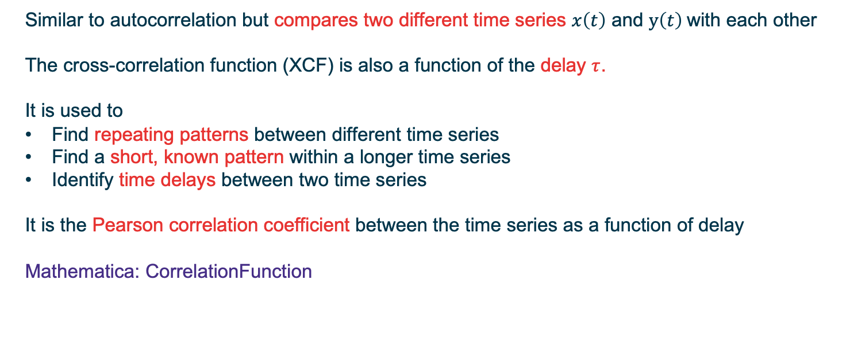

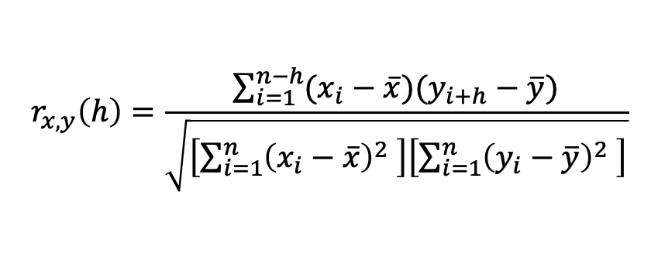
Cross-correlation
Similar to autocorrelation but compares two different time series $x\left(t\right)$ and $y\left(t\right)$with each other
The cross-correlation function (XCF) is also a function of the delay $τ$.
It is used to
Find repeating patterns between different time series
Find a short, known pattern within a longer time series
Identify time delays between two time series
It is the Pearson correlation coefficient between the time series as a function of delay
Mathematica: CorrelationFunction
$$r_{x,y}\left(h\right)=\frac{\sum_{i=1}^{n−h}{(x_{i}−\overline{x})(y_{i+h}−\overline{y})}}{\sqrt{\left[\sum_{i=1}^{n}{{\left(x_{i}−\overline{x}\right)}^{2} }\right]\left[\sum_{i=1}^{n}{{\left(y_{i}−\overline{y}\right)}^{2} }\right]}}$$
$$r_{x,y}\left(h\right)∈[−1, 1]$$

Slide 23
Cross-correlation
Raw time series
Cross-correlation function
Example: 05a_crosscorrelation_hands_on.nb

Slide 24
Spectral Analysis
Time series
Spectrum
Fourier transform
Is the signal dominated by particular frequencies?
What is the relative strength of these particular frequencies?
The main power of spectral analysis is that any signal (discrete or continuous) can be decomposed into a sum of oscillations with different frequencies

Slide 25
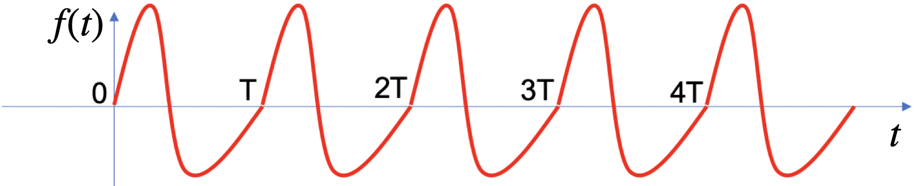
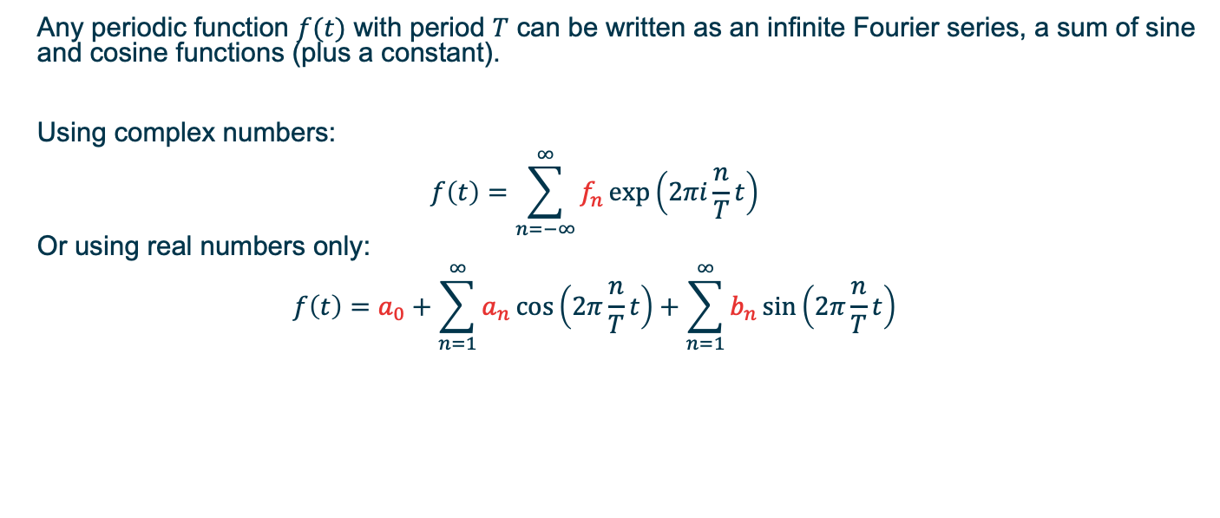
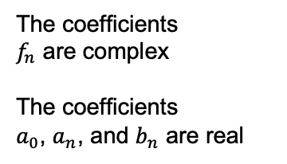
Fourier series
Any periodic function $f(t)$ with period $T$ can be written as an infinite Fourier series, a sum of sine and cosine functions (plus a constant).
Using complex numbers:
$$f\left(t\right)=\sum_{n=−∞}^{∞}{f_{n}\exp\left(2πi\frac{n}{T}t\right)}$$
Or using real numbers only:
$$f\left(t\right)=a_{0}+\sum_{n=1}^{∞}{a_{n}\cos\left(2π\frac{n}{T}t\right)}+\sum_{n=1}^{∞}{b_{n}\sin\left(2π\frac{n}{T}t\right)}$$
The coefficients $f_{n}$ are complex
The coefficients
$a_{0}$, $a_{n}$, and $b_{n}$ are real

Slide 26
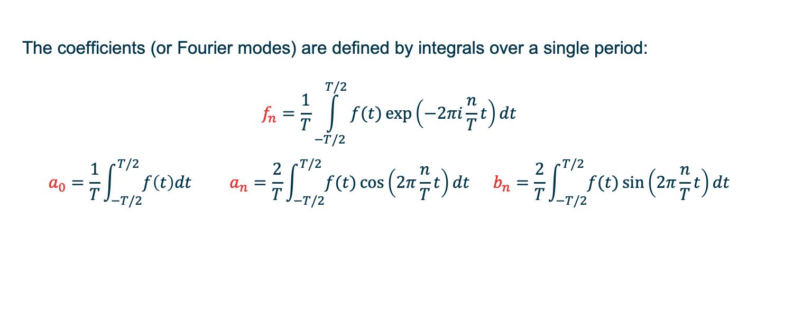

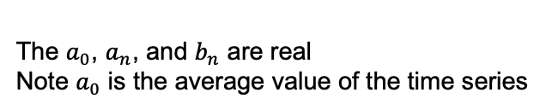
Fourier series
The coefficients (or Fourier modes) are defined by integrals over a single period:
$$f_{n}=\frac{1}{T}\int_{−T/2}^{T/2}{f(t)}\exp\left(−2πi\frac{n}{T}t\right)dt$$
$$a_{0}=\frac{1}{T}\int_{−T/2}^{T/2}{f\left(t\right)dt} a_{n}=\frac{2}{T}\int_{−T/2}^{T/2}{f(t)}\cos\left(2π\frac{n}{T}t\right)dt b_{n}=\frac{2}{T}\int_{−T/2}^{T/2}{f(t)}\sin\left(2π\frac{n}{T}t\right)dt$$
The $f_{n}$ are complex
The $a_{0}$, $a_{n}$, and $b_{n}$ are real
Note $a_{0}$ is the average value of the time series

Slide 27
Fourier series
Adding more sine/cosine functions approximates the signal better
Example: 06_sin_comb_fft.nb
1
2
“Gibbs phenomenon”
4
10
See also animations at https://en.wikipedia.org/wiki/Fourier_transform

Slide 28
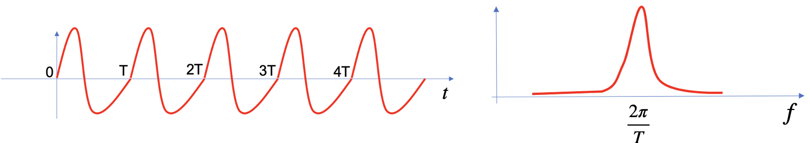
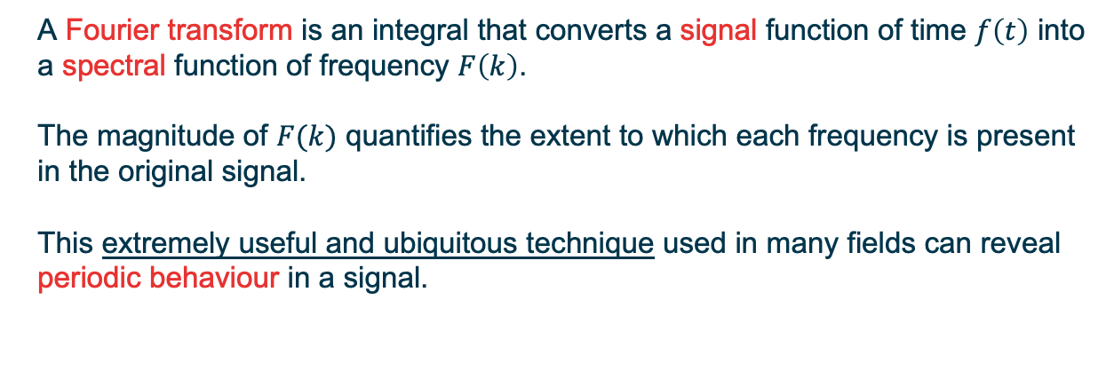
Discrete Fourier Transform (DFT)
Signal
Spectrum
A Fourier transform is an integral that converts a signal function of time $f\left(t\right)$ into a spectral function of frequency $F\left(k\right)$.
The magnitude of $F(k)$ quantifies the extent to which each frequency is present in the original signal.
This extremely useful and ubiquitous technique used in many fields can reveal periodic behaviour in a signal.

Slide 29
Discrete Fourier Transform (DFT)
Signal
Spectrum
In practice we almost always work with signals that are discretised in time. For discretised time series we use the Discrete Fourier Transform (DFT). This algorithm computes the coefficients of each of the Fourier modes corresponding to the original signal.
To compute the DFT we use a class of fast algorithms called a Fast Fourier Transform (FFT). The terms DFT and FFT are often used interchangeably, but you are more likely to see FFT in practical applications.
Mathematica: Fourier

Slide 30
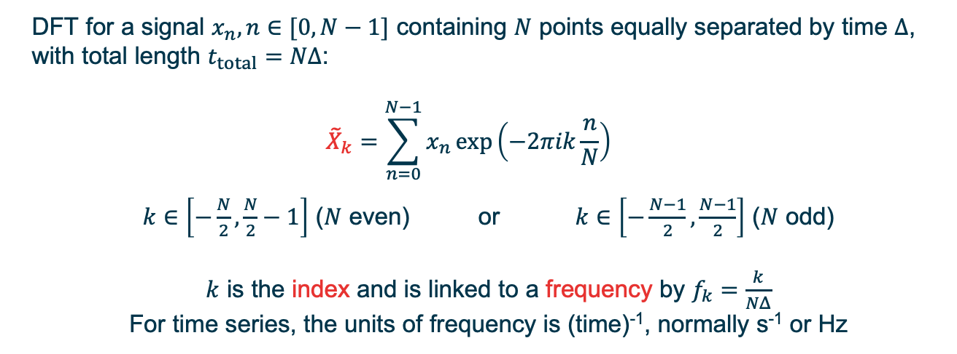
Discrete Fourier Transform (DFT)
Signal
Spectrum
DFT for a signal $x_{n}, n∈[0, N−1]$ containing $N$ points equally separated by time $Δ$, with total length $t_{total}=NΔ$:
$${\tilde{X}}_{k}=\sum_{n=0}^{N−1}{x_{n}\exp\left(−2πik\frac{n}{N}\right)}$$
$k∈\left[−\frac{N}{2}, \frac{N}{2}−1\right]$ ($N$ even) or $k∈\left[−\frac{N−1}{2}, \frac{N−1}{2}\right]$ ($N$ odd)
$k$ is the index and is linked to a frequency by $f_{k}=\frac{k}{NΔ}$
For time series, the units of frequency is (time)⁻¹, normally s⁻¹ or Hz

Slide 31
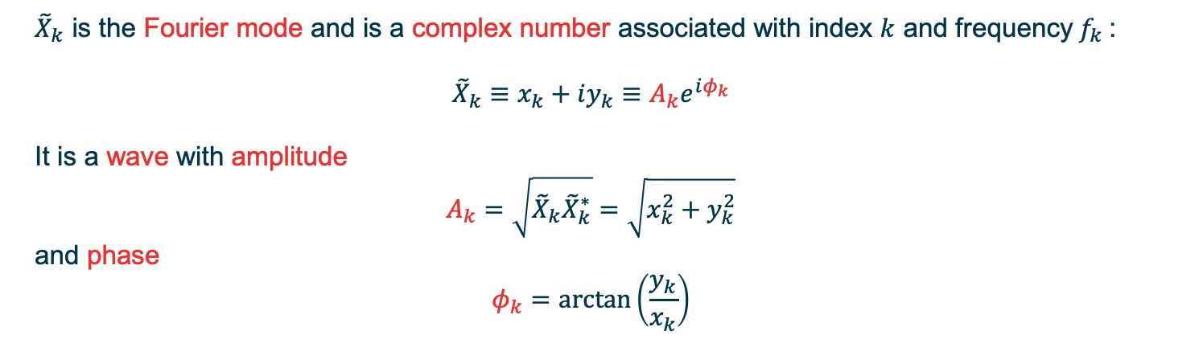
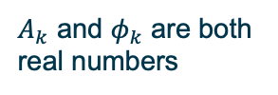
Discrete Fourier Transform (DFT)
Signal
Spectrum
${\tilde{X}}_{k}$ is the Fourier mode and is a complex number associated with index $k$ and frequency$f_{k}$:
$${\tilde{X}}_{k}≡x_{k}+iy_{k}≡A_{k}e^{iφ_{k}}$$
It is a wave with amplitude
$$A_{k}=\sqrt{{\tilde{X}}_{k}{\tilde{X}}_{k}^{∗}}=\sqrt{x_{k}^{2}+y_{k}^{2}}$$
and phase
$$φ_{k}=\arctan\left(\frac{y_{k}}{x_{k}}\right)$$
$A_{k}$ and $φ_{k}$ are both real numbers

Slide 32
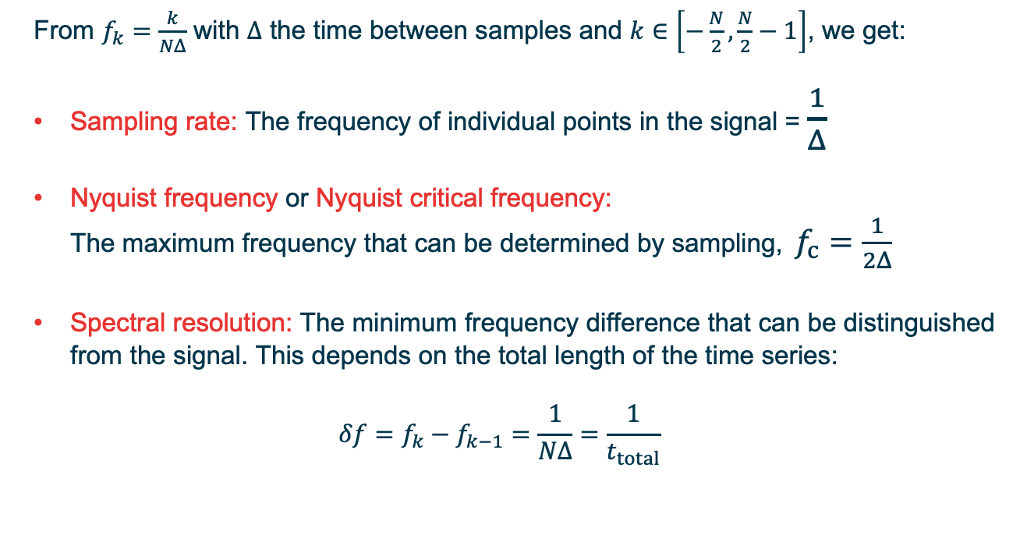
Discrete Fourier Transform (DFT)
From $f_{k}=\frac{k}{NΔ}$ with $Δ$ the time between samples and $k∈\left[−\frac{N}{2}, \frac{N}{2}−1\right]$, we get:
Sampling rate: The frequency of individual points in the signal = $\frac{1}{Δ}$
Nyquist frequency or Nyquist critical frequency: The maximum frequency that can be determined by sampling, $f_{c}=\frac{1}{2Δ}$
Spectral resolution: The minimum frequency difference that can be distinguished from the signal. This depends on the total length of the time series:
$$δf=f_{k}−f_{k−1}=\frac{1}{NΔ}=\frac{1}{t_{total}}$$
Example: 07_spectrum_DFT.nb

Slide 33
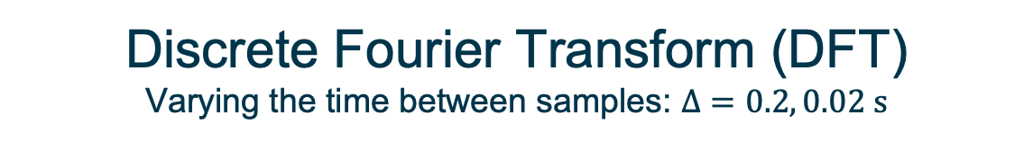
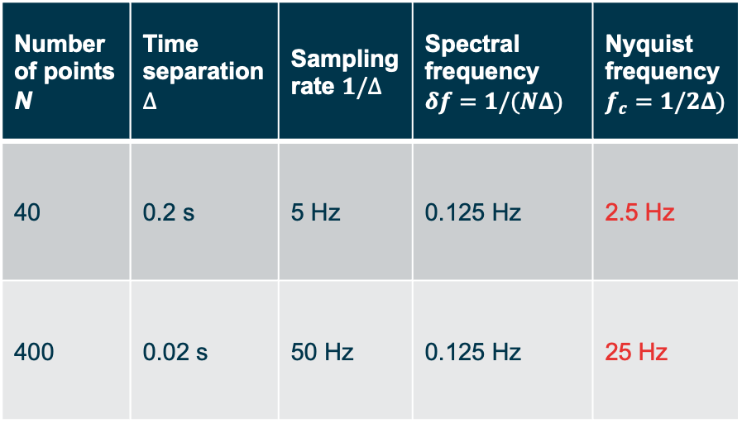
Discrete Fourier Transform (DFT)
Varying the time between samples: $Δ=0.2, 0.02 s$
Number of points N | Time separation $Δ$ | Sampling rate $1/Δ$ | Spectral frequency $δf=1/(NΔ)$ | Nyquist frequency $f_{c}=1/2Δ)$
40 | 0.2 s | 5 Hz | 0.125 Hz | 2.5 Hz
400 | 0.02 s | 50 Hz | 0.125 Hz | 25 Hz
Shortening the interval between samples enables the detection of higher frequencies

Slide 34
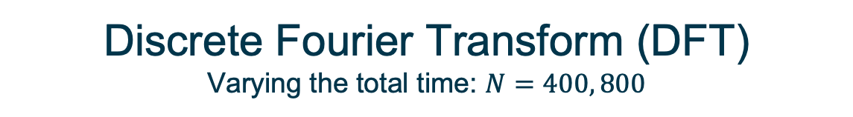
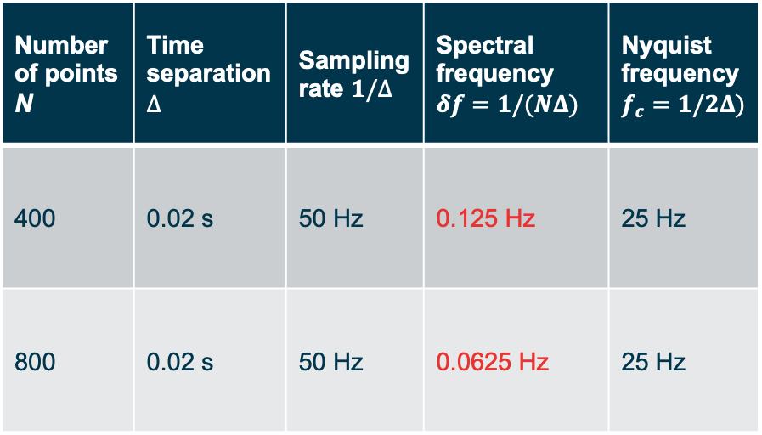
Discrete Fourier Transform (DFT)
Varying the total time: $N=400, 800$
Number of points N | Time separation $Δ$ | Sampling rate $1/Δ$ | Spectral frequency $δf=1/(NΔ)$ | Nyquist frequency $f_{c}=1/2Δ)$
400 | 0.02 s | 50 Hz | 0.125 Hz | 25 Hz
800 | 0.02 s | 50 Hz | 0.0625 Hz | 25 Hz
Lengthening the time series improves the resolution in the low-frequency range and makes the discrete frequency channels closer together

Slide 35
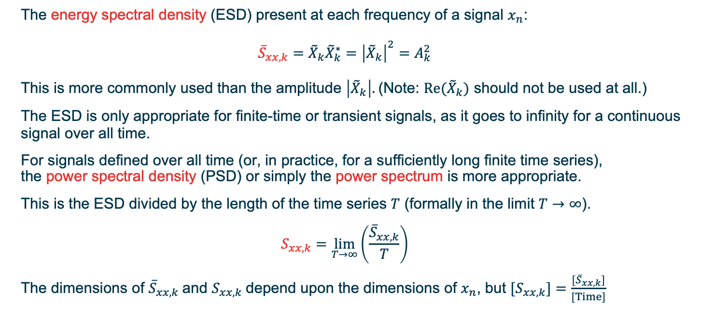
Power spectrum
The energy spectral density (ESD) present at each frequency of a signal $x_{n}$:
$${\overline{S}}_{xx,k}={{\tilde{X}}_{k}{\tilde{X}}_{k}^{∗}=\left|{\tilde{X}}_{k}\right|}^{2}=A_{k}^{2}$$
This is more commonly used than the amplitude $\left|{\tilde{X}}_{k}\right|.$(Note: ${Re(\tilde{X}}_{k})$ should not be used at all.)
The ESD is only appropriate for finite-time or transient signals, as it goes to infinity for a continuous signal over all time.
For signals defined over all time (or, in practice, for a sufficiently long finite time series), the power spectral density (PSD) or simply the power spectrum is more appropriate.
This is the ESD divided by the length of the time series $T$ (formally in the limit $T→∞$).
$$S_{xx,k}=\lim_{T→∞}\left(\frac{{\overline{S}}_{xx,k}}{T}\right)$$
The dimensions of ${\overline{S}}_{xx,k}$and $S_{xx,k}$depend upon the dimensions of $x_{n}$, but ${[S}_{xx,k}]=\frac{{[\overline{S}}_{xx,k}]}{[Time]}$
Mathematica: Periodogram

Slide 36
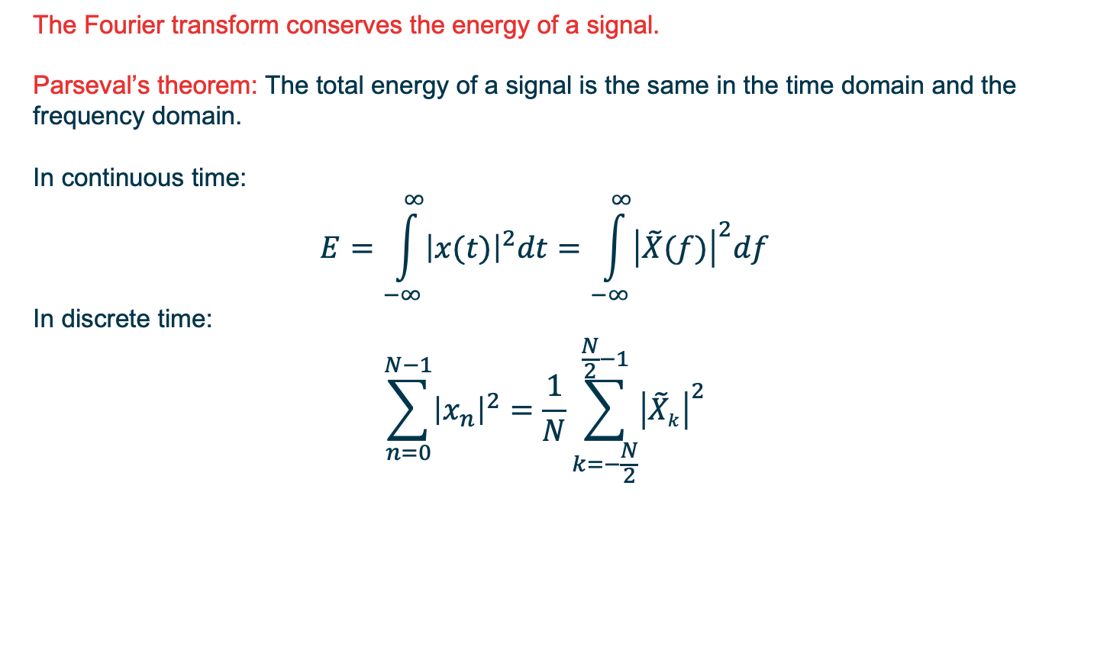
Power spectrum
The Fourier transform conserves the energy of a signal.
Parseval’s theorem: The total energy of a signal is the same in the time domain and the frequency domain.
In continuous time:
$$E=\int_{−∞}^{∞}{{\left|x(t)\right|}^{2}dt}=\int_{−∞}^{∞}{{\left|\tilde{X}(f)\right|}^{2}df}$$
In discrete time:
$$\sum_{n=0}^{N−1}{{\left|x_{n}\right|}^{2}}=\frac{1}{N}\sum_{k=−\frac{N}{2}}^{\frac{N}{2}−1}{{\left|{\tilde{X}}_{k}\right|}^{2}}$$
Note: Be careful applying this, as different algorithms define the LHS and RHS differently

Slide 37
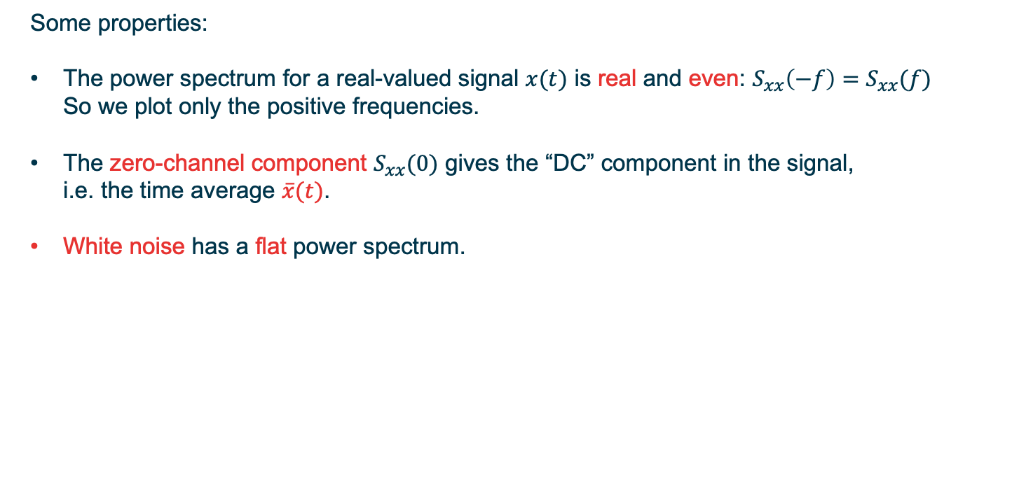
Power spectrum
Some properties:
The power spectrum for a real-valued signal $x(t)$ is real and even: $S_{xx}\left(−f\right)=S_{xx}(f)$ So we plot only the positive frequencies.
The zero-channel component $S_{xx}(0)$ gives the “DC” component in the signal, i.e. the time average $\overline{x}(t)$.
White noise has a flat power spectrum.

Slide 38
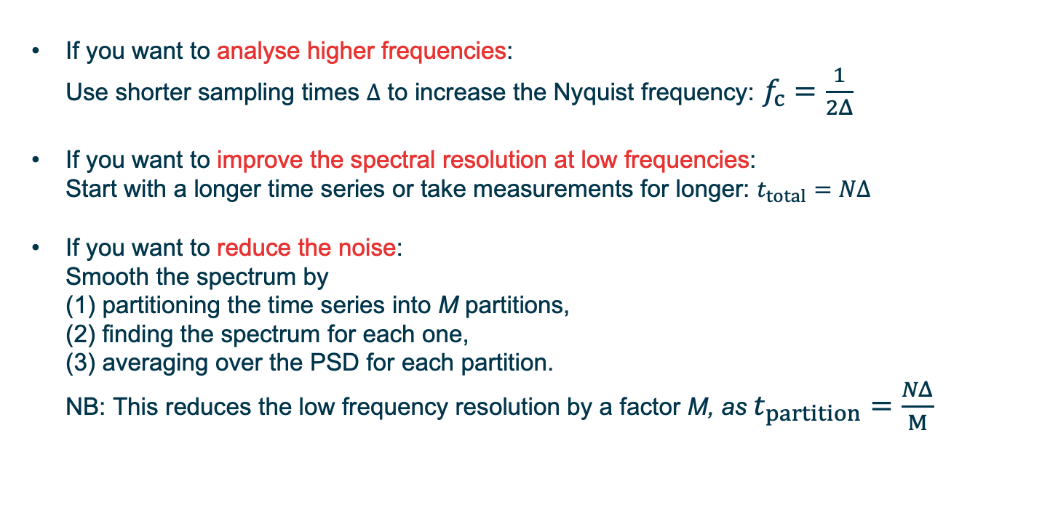
Optimising the power spectrum
If you want to analyse higher frequencies: Use shorter sampling times $Δ$ to increase the Nyquist frequency: $f_{c}=\frac{1}{2Δ}$
If you want to improve the spectral resolution at low frequencies: Start with a longer time series or take measurements for longer: $t_{total}=NΔ$
If you want to reduce the noise: Smooth the spectrum by (1) partitioning the time series into M partitions, (2) finding the spectrum for each one, (3) averaging over the PSD for each partition. NB: This reduces the low frequency resolution by a factor M, as $t_{partition}=\frac{NΔ}{M}$
Examples: 08a_temperature_Scot_hands_on.nb
09a_spectrum_spiketimes_hands_on.nb

Slide 39
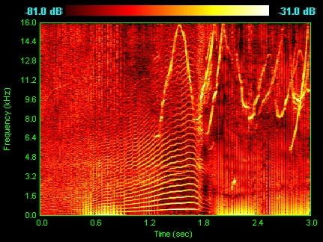
Short-time Fourier transform
The Fourier transform and the power spectrum give averaged information about each frequency over the whole time series. Frequency changes over time cannot be detected.
To analyse changes in the spectrum over time, we can partition the time series and perform spectral analyses for each (short) partition individually, without averaging the spectra.
This 2D spectrum is called a spectrogram.
Mathematica: Spectrogram
Particularly used in the analysis of audio signals,
ecology, and seismology.
Spectrogram of a dolphin’s vocalisations
Chirps
Tradeoff: Time and frequency resolution are inversely proportional. As you shorten the partition, you detect changes over shorter intervals, but the frequency resolution decreases
Harmonising
Clicks
Example: 10_spectrogram.nb
[Spyrogumas/CC BY-SA 3.0]

Slide 40

Filtering in the frequency domain
The action of a filter or smoother is often easier to understand in the frequency domain.
A “filter” acts to modify or remove certain frequencies in the data.
It may not necessarily make the data visually “smoother” (although it can).
Applying a weighted average function window through the time series in the time domain (mathematically: convolution) is equivalent to multiplication in the frequency domain.
Examples of types of filter in the frequency domain
Red lines indicate multiplication applied to spectrum as a function of frequency (maximum = 1)
[Spinningspark/CC BY-SA 3.0]

Slide 41
Filtering in frequency space
LowpassFilter Removes or attenuates frequencies above a cutoff frequency
(i.e. lets low frequencies pass)
NB: Cutoff is not usually a step; different shapes are possible Good for removing noise and “smoothing”
HighpassFilter Removes or attenuates frequencies below a cutoff frequency
(i.e. lets high frequencies pass)
Good for removing long-term trends and cycles
BandpassFilter Lets through a range (band) of frequencies around a particular frequency
Allows you to examine specific periodic behaviour
BandstopFilter Removes a range of frequencies around a particular frequency
If the band is very narrow, this is called a notch filter
Allows you to remove specific periodic behaviour
e.g. a fixed oscillation due to something in the measuring device
Example: 11_frequency_filtering.nb

